Slide 1



Slide 2






Who | How | What
GEM is an independent company specialising in professional expediting services worldwide, with over 35 years' experience working within most leading EPCM companies and manufacturing facilities. | Providing an efficient and robust expediting service that exceeds project expectations, underpinned by extensive cross-sector experience and a time tested quality management system. | Offering an extensive range of expediting services for all sectors of the industry, including materials procurement, inventory control and management, logistics planning and documentation delivery.
Why | Where | When
The passion for what we do and the desire for continuous improvement makes GEM an ideal partner. Building relationships based on trust and performance ensures for a successful, collaborative experience. | GEM provide expediting services for sectors of the industry, including Oil & Gas, Energy, Mining, Rail, Marine and Rail. Our extensive client base extends across the globe spanning 5 continents. | The scale and scope of required services differ from project to project. In order to provide an accurate estimate of when GEM will be able to offer services, please contact us via our website.

Slide 3



Setting the standard for excellence in procurement and expediting, through total commitment to quality in people and customer service, ensuring projects are delivered on time and to cost.

Slide 4



What We Do
People
Services
Quality
Our GEM staff team are characterised by their compassion, integrity, professionalism and commitment.
Our good reputation and the quality of our current services are due to the commitment and competence of our staff.
GEM offer services catering for the entire expediting spectrum, including but not limited to:
In-House expediting, Field expediting, Critical and non critical documentation, Raw material status, Bespoke Reporting, Production control, Quality control and Project management.
GEM is accredited to ISO 9001:2015 and operate Total Quality Management (TQM).
We work with independent quality experts to create a tailored system, facilitating both structure and flexibility - ensuring compliance with customer and industry requirements.
“Satisfy your needs and exceed expectations”

Slide 5
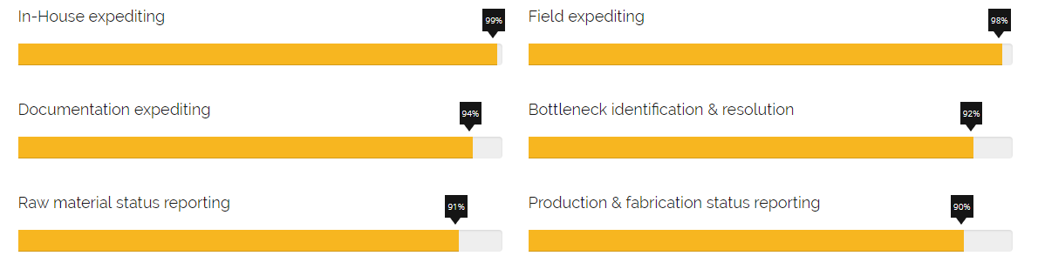
Our Most Utilised Services
“Knowing exactly what is required to achieve all stakeholder goals”

Slide 6

Where we operate
Marine & Subsea
Power Generation
Mining
Manufacturing
Oil & Gas
Energy & Chemicals
Petrochemical
Rail
“21 Major Projects, spanning 5 continents with 35 years of Experience”

Slide 7
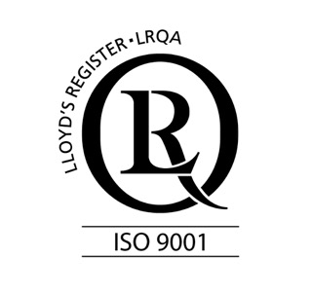




World-class Quality Assurance
Total Quality Management
Working with independent quality experts to create a tailored system, facilitating structure and flexibility, ensuring full compliance with customer and industry requirements.
ISO 9001:2015
GEM quality plan has been accredited to ISO 9001 latest edition, and is fully integrated throughout the services offered. Regular audits are carried out to ensure continuous improvements are being managed.
Increased Efficiency
By following industry best-practice and focusing on quality GEM reduces overall client costs, resulting in higher levels of customer satisfaction.
“Accredited to ISO 9001:2015, ensuring Quality assurance at every level”

Slide 8
Projects Managed – Oil & Gas
Worley Parsons – TANAP Project, Turkey
Fluor - Future Growth Project, Client – TCO
Fluor - SADARA, Saudi Arabia
AMEC - BP Clair Ridge
CB&I - Mariner Project, DSME – Statoil
Worley Parsons - JASMINE, North Sea
KBR - GORGAN, WA Barrow Island
Ferrostaal BV – FPSO Package – CTF Brazil
Foster Wheeler - SPT Singapore parallel train
Foster Wheeler - EPCL Naphtha Hydrotreater Reformer
Fluor - PFD/TCO, Location – Kazakhstan
Bechtel - KARACHAGANAK Consortium
Solar Turbines - Margham Dubai
Balanak Project – KBR
KBR - Block 18 – BP
Mouchel – Gas Port – Excelerate Energy
Fluor - Future Growth Project
Pipeline Project (TANAP), Turkey
Fluor - SADARA, Saudi Arabia
AMEC - BP Clair Ridge
Worley Parsons - JASMINE
CB&I - Mariner Project

Slide 9
Projects Managed – Other
Racal Translink Connect
Jubilee Line Extension
Fluor - Simandou Iron Ore, South Africa
RAIL
Racal Translink Connect
Jubilee Line Extension
Mining & Metals
Fluor - Simandou Iron Ore,
South Africa, Guinea

Slide 10
Happy Clients
“Expediting is normally under rated in oil and gas industry. I was not aware of how expediting could impact packages smooth progress and how it could affect other disciplines within the project until I had the honour to work with Mark on several packages. GEM was capable of making the most difficult packages easy to manage. They are a great asset to all project functions, being quality or engineering. Needless to say that GEM's expertise and foresight saved us numerous embarrassments and what surprises me is that they do all this so effortlessly. They never ceases to reach out and help other disciplines always maintaining a focused, cordial and professional relation with vendors. Thank you GEM. I learned a lot and after 28 years in the oil and gas business with 16 EPCM projects under my wing, after I thought I have seen them all, but you proved me wrong. It is simply amazing what a good expediting can do to a project.”
QA QC Director | QEC
“Professional and hard working company who has helped me within the oil and gas industry, provides support and vast knowledge throughout the course of any project.”
Project Manager | Bechtel Ltd

Slide 11


Get In Touch
If you would like to hear how GEM could add value to your project or organisation, please contact us using the details below:
Mark J Wood
+(44) 07590335565
mark.j.wood@global-expediting.co.uk
Greg Abbott
+(44) 07969921724
greg.abbott@global-expediting.co.uk

